Slide 1

Pattern Classification
All materials in these slides were taken from
Pattern Classification (2nd ed) by R. O. Duda, P. E. Hart and D. G. Stork, John Wiley & Sons, 2000
with the permission of the authors and the publisher

Slide 2
Chapter 2 (Part 2):
Bayesian Decision Theory
(Sections 2.3-2.5)
Minimum-Error-Rate Classification
Classifiers, Discriminant Functions and Decision Surfaces
The Normal Density

Slide 3
Minimum-Error-Rate Classification
Actions are decisions on classes
If action α_{i} is taken and the true state of nature is ω_{j} then:
the decision is correct if i = j and in error if i ≠ j
Seek a decision rule that minimizes the probability of error which is the error rate

Slide 4
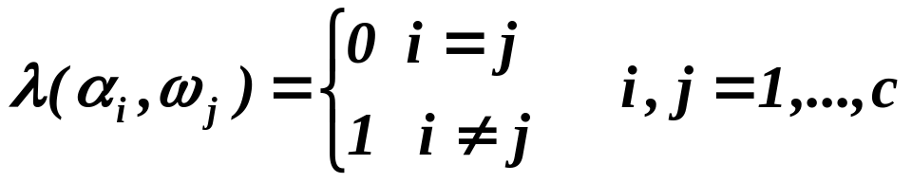
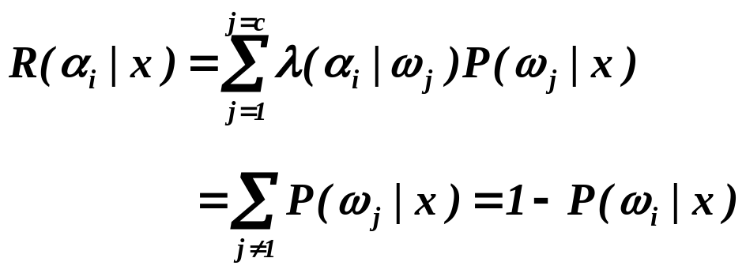
Introduction of the zero-one loss function:
Therefore, the conditional risk is:
“The risk corresponding to this loss function is the average probability error”

Slide 5
Minimize the risk requires maximize P(ω_{i} | x)
(since R(α_{i} | x) = 1 – P(ω_{i} | x))
For Minimum error rate
  Decide ω_{i} if P (ω_{i} | x) > P(ω_{j} | x) ∀j ≠ i

Slide 6
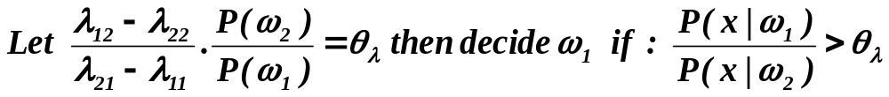
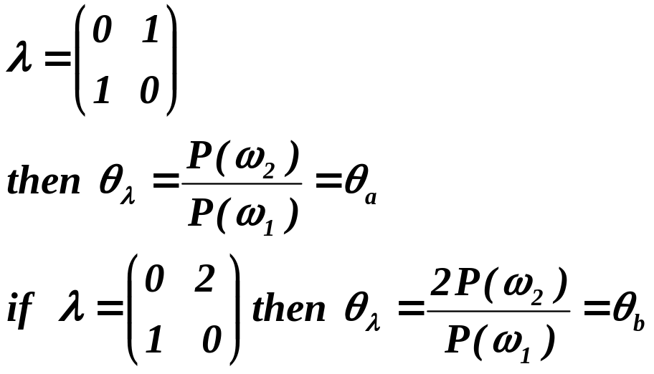
Regions of decision and zero-one loss function, therefore:
If λ is the zero-one loss function wich means:

Slide 7
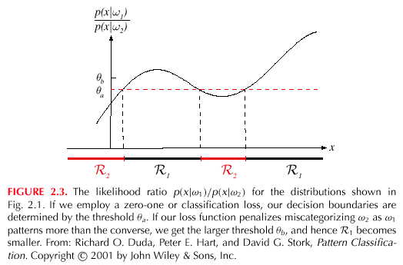

Slide 8
Classifiers, Discriminant Functions and Decision Surfaces
The multi-category case
  Set of discriminant functions g_{i}(x), i = 1,…, c
  The classifier assigns a feature vector x to class ω_{i}
  if:
  g_{i}(x) > g_{j}(x) ∀j ≠ i

Slide 9
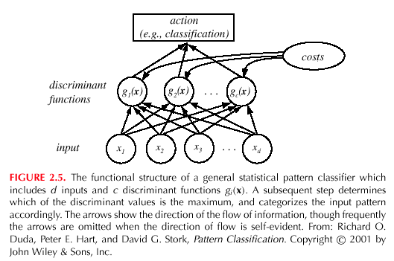

Slide 10
Let g_{i}(x) = - R(α_{i} | x)
(max. discriminant corresponds to min. risk!)
For the minimum error rate, we take
  g_{i}(x) = P(ω_{i} | x)
(max. discrimination corresponds to max. posterior!)
g_{i}(x) ≡ P(x | ω_{i}) P(ω_{i})
g_{i}(x) = ln P(x | ω_{i}) + ln P(ω_{i})
(ln: natural logarithm!)

Slide 11
Feature space divided into c decision regions
if g_{i}(x) > g_{j}(x) ∀j ≠ i then x is in R_{i}
(R_{i} means assign x to ω_{i})
The two-category case
  A classifier is a “dichotomizer” that has two discriminant functions g₁ and g₂
  Let g(x) ≡ g₁(x) – g₂(x)
  Decide ω₁ if g(x) > 0 ; Otherwise decide ω₂

Slide 12
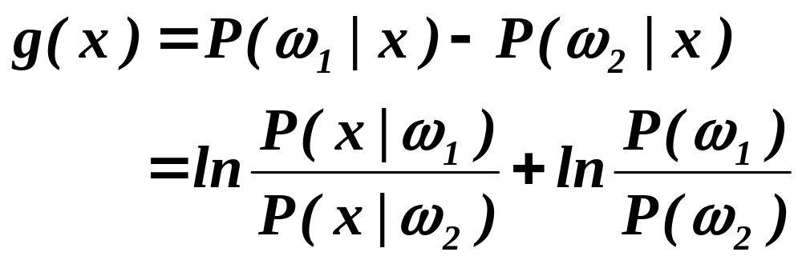
  The computation of g(x)

Slide 13
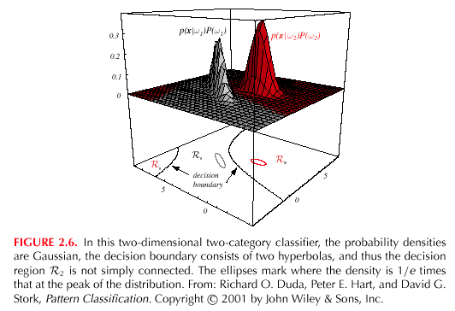

Slide 14
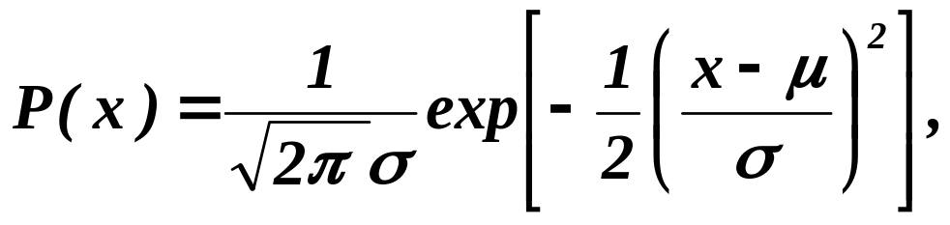
The Normal Density
Univariate density
  Density which is analytically tractable
  Continuous density
  A lot of processes are asymptotically Gaussian
  Handwritten characters, speech sounds are ideal or prototype corrupted by random process (central limit theorem)
Where:
μ = mean (or expected value) of x
σ² = expected squared deviation or variance

Slide 15
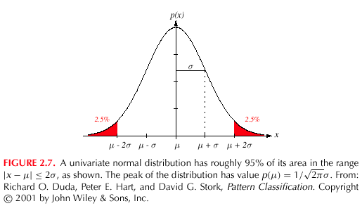

Slide 16
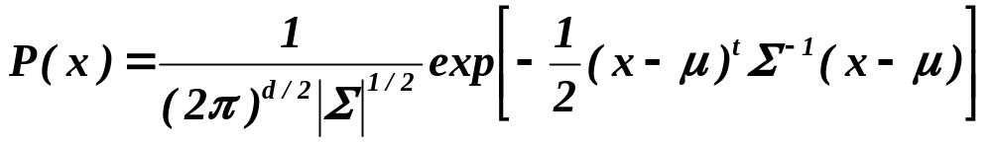
Multivariate density
  Multivariate normal density in d dimensions is:
where:
x = (x₁, x₂, …, x_{d})^{t} (t stands for the transpose vector form)
μ = (μ₁, μ₂, …, μ_{d})^{t} mean vector
Σ = d*d covariance matrix
|Σ| and Σ⁻¹ are determinant and inverse respectively

